Slide 1
ELECTRONIC FETAL MONITORING (EFM) / CARDIOTOCOGRAPHY(CTG).
Dr Rehana Raja
King Khalid University
Abha, KSA

Slide 2
Format
History
The methods available
Basic physiology
Indications
Features of CTG – Normal & Abnormal
Management of abnormal CTG
Fetal Blood Sampling
The future?

Slide 3
HISTORY
1876 – Pinnard designed Pinnards stethoscope
Early 1970s-Electronic fetal monitoring introduced in clinical practice
Early hopes were prevention of cerebral palsy and reduction of perinatal mortality
FHR patterns were thought to reflect hypoxia- fetal distress
EFM did NOT reduce Perinatal mortality but leads to an INCREASE of C-Sections

Slide 4


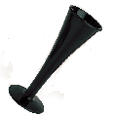
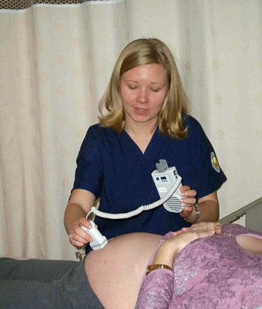


Two methods - auscaltatory and electronic

Slide 5
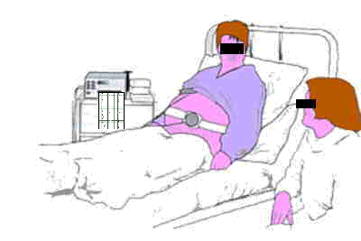
5

Slide 6
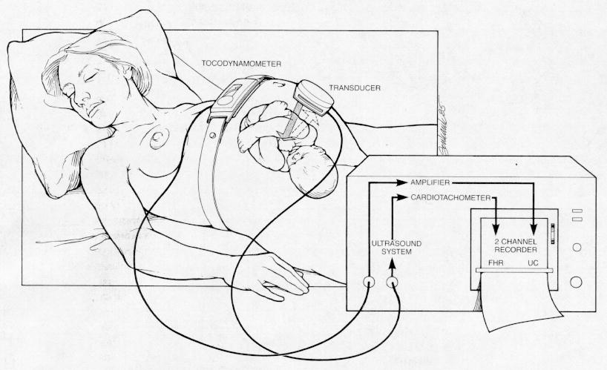
External Fetal Monitoring

Slide 7
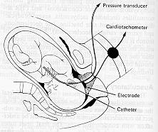
Internal Fetal Monitoring

Slide 8
Fetal Monitoring in Labor: Two Acceptable Methods
Electronic
  In “active” labor – by convention needs to be continuous
  Does not reduce perinatal mortality
  Increases c-section rates
  Variable interpretations
Auscultatory - Pinnards
  Prescribed intervals
  Various devices but one recorded number
  Easy to interpret
  Intermittent
  Acceptable for “high” risk patients

Slide 9
Monitoring in an uncomplicated pregnancy
For a woman who is healthy and has had an otherwise uncomplicated pregnancy, intermittent auscultation should be
offered and recommended in labour to monitor fetal wellbeing.
In the active stages of labour, intermittent auscultation should occur
after a contraction, for a minimum of 60 seconds, and at least:
• every 15 minutes in the first stage
• every 5 minutes in the second stage.
Grade A Recommendation

Slide 10
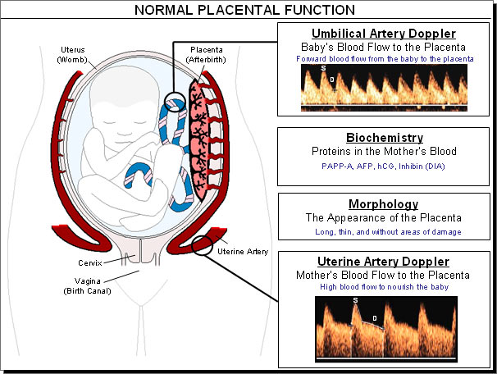
Basic Physiology

Slide 11
Factors Necessary for
Optimal Fetal Well-Being
Intact, functional maternal physiology
Intact, functional placenta
Intact, functional fetus

Slide 12
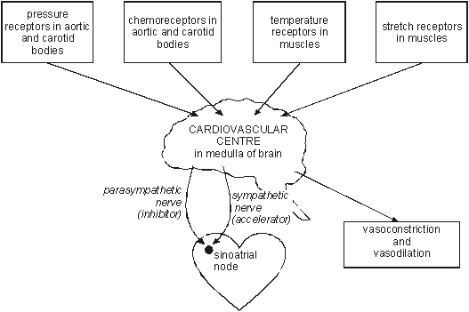
Autonomic control in fetus

Slide 13
PROBLEMS with EFM
EFM does not improve perinatal mortality
Excess of operative deliveries ( ACOG 2009)
Interobserver and intraobserver variations in interpretation
Lack of consistency and standardization of definitions eg fetal distress—reassuring/non reassuring trace, pathological / suspicious
Lack of training/education and evaluation

Slide 14
In Practice a CTG is best regarded as a screening tool:
High negative predictive value
    >98% of fetuses with a normal CTG will be OK
Poor positive predictive value
    50% of fetuses with an abnormal CTG will be hypoxic and acidotic but 50% will be OK
Therefore the CTG should always be interpreted in its clinical context
And backed by fetal blood sampling PRN

Slide 15
Indications for the
use of continuous EFM

Slide 16
Selected High-Risk Indications for Continuous Monitoring of Fetal Heart Rate
Maternal medical illness
Gestational diabetes
Hypertension
Asthma
Obstetric complications
Multiple gestation
Post-date gestation
Previous cesarean section
Intrauterine growth restriction
Oligohydramnios
Premature rupture of the membranes
Congenital malformations
Third-trimester bleeding- Antepartum haemorrhage
Oxytocin induction/augmentation of labor
Preeclampsia
Meconium stained liquor

Slide 17
Documentation
The following should be recorded
  woman’s name and MRN,
  estimated gestational age,
  clinical indications for performing the CTG
  time and date
  maternal pulse rate.
  Signature with time and date
The outcome of the FHR pattern should be documented both on the CTG and in the woman’s medical records and signed by the doctor
Notes:
This needs HUGE!!! emphasis as it is so important both legally and for communication between all clinicians.
Emphasize ++++++++
This is BEST PRACTICE.

Slide 18
BASICS
Speed of paper is usually 1cm per minute – hence I big square is 1 minute
The units used on the paper – 1 small square is 5 beats in the vertical axis
Sleeping cycle of fetus is 30 t0 40 mins – CTG should be done for atleast 20 to 30 mins- one can stimulate to awaken the baby like acoustic stimulation or a simple tap on the abdomen
CTG can be used in the antenatal period for fetal surveillance –Stress and non stress tests
Should NOT be done on Fetuses < 28 weeks

Slide 19
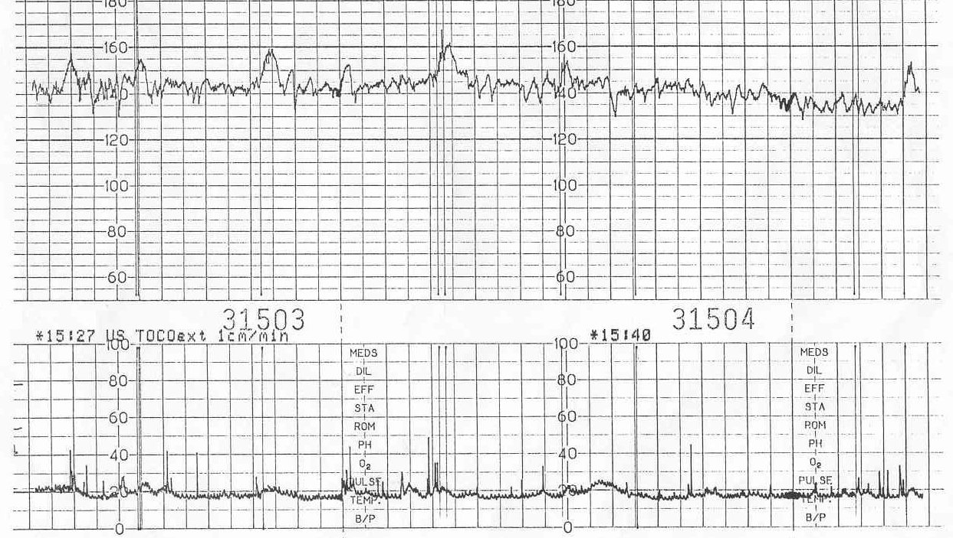
Features of a CTG
Baseline Heart Rate
Short term variability
Accelerations
Decelerations
Response to stimuli
    Contractions
    Fetal movements
    Others eg drugs eg pethidine

Slide 20
Baseline Fetal Heart Rate
Normal rate 110 to 150 bpm at term
Faster in early pregnancy
Below 100 = baseline bradycardia
Below 80 = severe bradycardia
Tachycardia > 160 bpm
Tachycardia if mother has fever

Slide 21
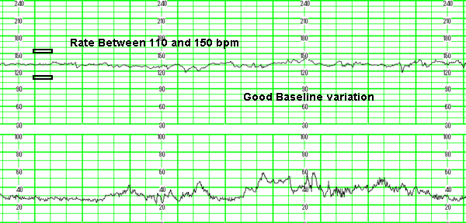
21

Slide 22
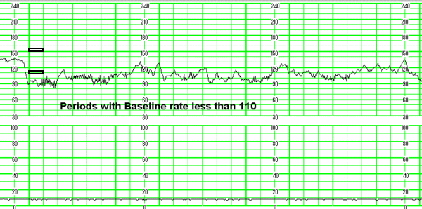
BRADYCARDIA
22

Slide 23
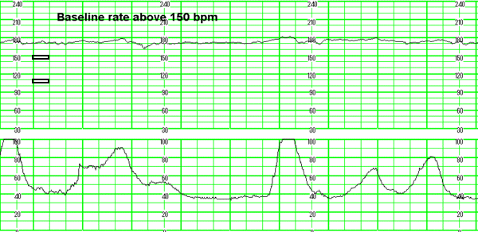
Hypoxia Chorioamnionitis
Maternal fever B-Mimetic drugs
Fetal anaemia,sepsis,ht failure,arrhythmias
TACHYCARDIA
23

Slide 24
Short Term Variability or
Beat to Beat Variability
Should be 10 to 25 beats
The most important feature of any CTG
Is a reflection of competing acceleratory and decelerating CNS influences on the fetal heart
Represents the best measure of CNS oxygenation
Will be affected by drugs
Will be reduced in the pre term fetus

Slide 25
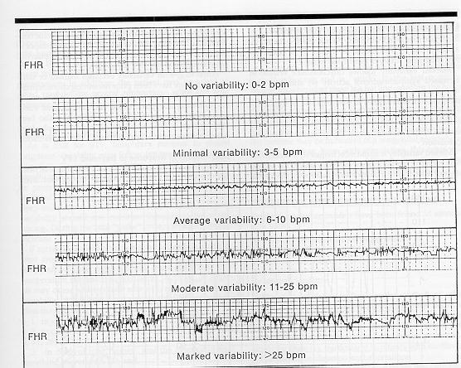

Slide 26
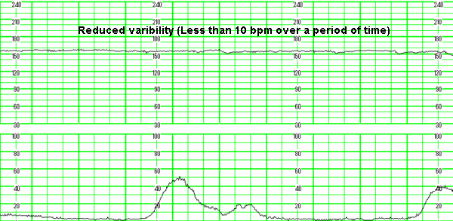
REDUCED VARIABILITY
Hypoxia Drugs Extreme prematurity
Sleep CNS abno.
26

Slide 27
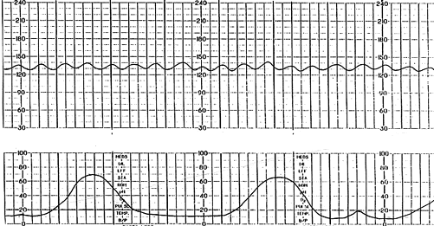
SINUSOIDAL
Dr Mona Shroff www.obgyntoday.info
27

Slide 28
Sinusoidal pattern
A regular oscillation of the baseline long-term variability resembling a sine wave. This smooth, undulating pattern, lasting at least 10 minutes, has a relatively fixed period of 3–5 cycles per minute and an amplitude of 5–15 bpm above and below the baseline. Baseline variability is absent
Associated with -
Severe chronic fetal anaemia
Severe hypoxia & acidosis
28

Slide 29
Accelerations
Must be >15 bpm and >15 sec above baseline
Should be >2 per 15 min period
Always reassuring when present
May not occur when fetus is “sleeping”
Should occur in response to fetal movements or fetal stimulation
Non reactive periods usually do not exceed 45 min
    >90 min and no accelerations is worrying

Slide 30
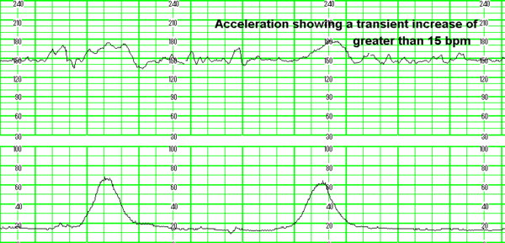
ACCELERATIONS
30

Slide 31
Decelerations
Early: mirrors the contraction
    Typically occurs as the head enters the pelvis and is compressed, i.e. it is a vagal response
Late: Follows every contraction and exhibits a slow return to baseline
    Is quite rare but is the response of a hypoxia
Variable: Show no relationship to contractions
    Mild
    Moderate
    Severe
In practice many “decels” or “dips” are MIXED

Slide 32
DECCELERATIONS
EARLY : Head compression
LATE : Utero placental insufficiency
VARIABLE : Cord compression
Primary CNS dysfunction
32

Slide 33
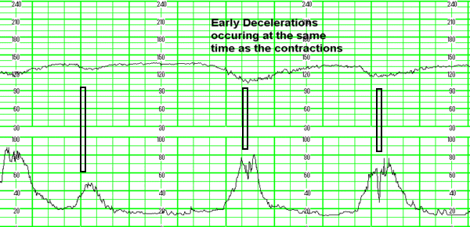
EARLY
33

Slide 34
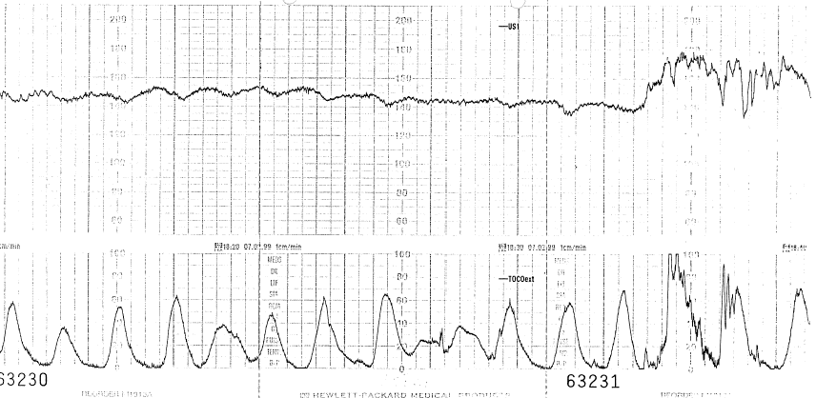
Notes:
If you draw a line at the peak of the contraction the deceleration will be occurring at the same time
In this case you may point out that there is a decrease in variability which is short lived (~20 mins)
and this is common with fetal sleep (when early decelerations also occur)

Slide 35
Early decelerations
Begin with head compression.
This reduction of cerebral blood flow leads to hypoxia and hypercapnia
Hypercapnia leads to hypertension with triggering of baroreceptors
Results in bradycardia mediated by parasympathetic nervous system (via the vagal nerve)
Fall in FHR is matched to rise in contraction strength
Not indicative of fetal compromise
Notes:
Parasympathetic nervous system slows the fetal heart rate

Slide 36
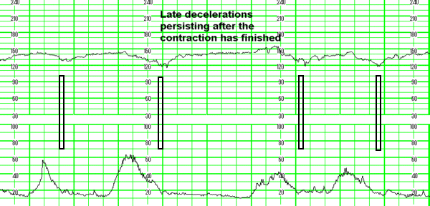
LATE
36

Slide 37
Late Decelerations
Repetitive from one contraction to the next (3 or more)
Recovery to baseline is late, well after the end of the contraction
More ominous when associated with minimal variability & ↑ baseline
Reflects a change in placental ability to adequately meet fetal needs
May indicate the presence of fetal hypoxia and acidosis
Often signifies fetal decompensation
Notes:
These late decelerations ‘party’ in a group together.
It could be likened to the fetus ‘running on empty’.
The % of fetuses that are acidotic is about 1 in 3 where there are late decelerations.

Slide 38
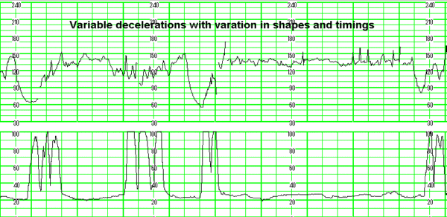
VARIABLE
38

Slide 39
Variable Decelerations
Repetitive or intermittent
Often mimic letters of the alphabet
U V W M
Rapid sudden fall in FHR
Often rapid recovery
Reflect some degree of umbilical cord impingement
Often seen when liquor volume is ↓
Notes:
RCOG describe two types of variables, typical and atypical and both will be covered
These are the most common decelerations seen in labour.
The W and M types often means that there is a “late” component.

Slide 40
FHR evaluation
Dr C Bravado © ALSO
DR – determine the risk
C – contractions
Bra – baseline rate
V – variability
A – accelerations
D – decelerations
O – overall assessment (followed by a management plan)
Notes:
Dr C Bravado was developed as a tool for interpretation of intrapartum FHR patterns and thanks to ALSO for allowing us to use the mnemonic.

Slide 41
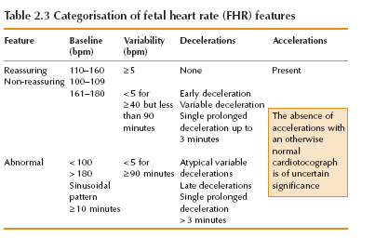
41

Slide 42
Categorisation of fetal heart rate traces
Category | Definition
Normal | All four reassuring
Suspicious | 1 non-reassuring Rest reassuring
Pathological | 2 or more non-reassuring 1 or more abnormal
42

Slide 43
Suspicious FHR Pattern: What should you do?
Maternal
Position
Dehydration
Infection
Hypotension
?Vaginal exam/bedpan
Vomiting/vasovagal
Analgesia/Drugs
Mechanical
Poor quality CTG
Maternal pulse
Transducer site
Fetal scalp electrode
Oxytocics
Prostaglandins
Notes:
Change position L lateral preferably
Check BP 500mls crystalloid if appropriate
O₂ administration – the prolonged use of O₂ may be harmful to the fetus and should be avoided.
There is no research evidence evaluating the benefits or risks associated with the short term use of maternal facial oxygen therapy in cases of suspected fetal compromise. (NICE 2001)
Remember ChICKeN !!!!!!

Slide 44
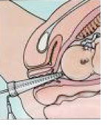
Fetal Blood Sampling

Slide 45
Pathological: What should I do?
Roll woman into left lateral position, give oxygen, iv fluids & continue CTG monitoring
Perform Fetal Blood Sampling
  If pH ≥7.25 repeat within one hour if the FHR abnormality persists
  If pH 7.21-7.24 repeat within 30mins or deliver if rapid fall since last FBS
  If pH < 7.20 DELIVER immediately
  Lactate 4.2 - 4.8 DELIVER – brain injury begins at 6mmols or higher
  All FBS should take into account previous pH, rate of progress & clinical information
Notes:
Lactate increases at approximately 1mmol every 25 minutes.
Fetal brain injury begins to occur at a lactate level of 6mmol and greater.
The decisions regarding which is the most appropriate lactate level for the decision to deliver to occur needs to remain at the local level as each hospital will have different on call arrangements and the the level will be dependent on the availability of staff and other resources.

Slide 46
And finally…
For the electronic fetal monitoring to be effective, the test must be performed correctly, its results must then be interpreted satisfactorily and finally this interpretation must provide an appropriate response
Room for newer methods?? DEFINITELY!!!
THANK YOU

