Slide 1
Chronic Diarrhea
Presented by:
Bandar Dallak
Faisal Al-Qahtani
Ali Al-Zahrani
Saeed Al-Shreef

Slide 2
Introduction:
Diarrhea is an increase in fluidity, volume and frequency of stools relative to the usual habits of an individual.
≥ 3/day loose, watery stool.

Slide 3
Introduction:
The great majority of diarrhea episodes last less than one week;
When diarrhea persists for more than 14 days, it is called persistent, intractable, or chronic diarrhea.

Slide 4
Introduction:
In the developing world, persistent diarrhea usually follows an acute episode and typically is associated with serial enteric infections without time to recover between episodes.
Children are at risk of malnutrition and often have other intercurrent illnesses, such as respiratory infections.

Slide 5
Introduction:
In developed countries, children are less likely to be exposed to serial enteric infections and malnutrition.
In these populations, chronic diarrhea is more likely to be caused by underlying disease, such as celiac disease or other food allergy.

Slide 6
Introduction:
Sequelae:
Dehydration.
Marked weight loss and malnutrition.
FTT.

Slide 7
There are four basic pathophysiological categories of diarrhea
(1) Osmotic Diarrhea: when an ingested solute is not absorbed properly, the higher concentration gradient within the gut lumen acts to draw water into intestinal lumen and greatly increases the water content of the stool. The classic example of this is the diarrhea caused by lactose intolerance. Enteric infections may also cause malabsorption via damage to intestinal epithelial cells (ex. Rotavirus or Shigella).

Slide 8
(2) Secretory Diarrhea: this diarrhea is caused by the intestine actively secreting water into the gut lumen. Infections such as Cholera, Clostridia Perfringens, Clostridia Difficile, E. Coli, Staph. Aureus, and Shigella all cause secretory diarrhea mainly via
preformed enterotoxins.
(3) Inflammatory Diarrhea: Intestinal inflammation can lead to blood, mucus, and protein exudate losses, accompanied by fluid and electrolytes. The most common cause of this type of diarrhea is infection but can also be due to chronic diseases such as IBD or Celiac Disease.
(4) Diarrhea due to Motility Disorders: although uncommon, both an increase and a decrease in gut motility can be a cause of diarrhea.
Note: diarrhea can be caused by one or any combination of these categories

Slide 9
Causes

Slide 10
CAUSES:
Chronic Diarrhea
Infections
Endocrine
Chronic nonspecific diarrhea.
Carbohydrates malabsorption
Dietary
Immune defects
Metabolic defects
Pancreas
Small intestine
IBS
IBD
Viral, parasitic, bacterial,..
Hyperthyroidism.
Adrenal insufficiency.
Celiac disease.
Cystic fibrosis.
Lactase deficiency.
Glucose-glactose malabsorption.
Cow’s Milk/soy protein intolerance.
Familial chloride diarrhea.
Agammaglobulinemia
IgA deficiency.
AIDS.

Slide 11
Infections
Parasitic
Bacterial
Post infectious
Giardasis.
Ascaris.
Amoeba.
Ankylostoma.
Salmonella.
Campylobacter
Antibiotic induced: C. difficile
secondary lactase deficiency

Slide 12
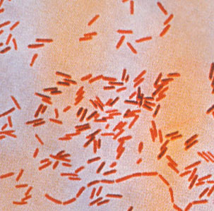
Typhoid:
Caused by S. typhi and S. paratyphi.
Transmitted through contact with infected animals e.g., chicken, or through contaminated food e.g., eggs, dairy products.

Slide 13
Typhoid:
C/P:
Bactremia and high grade fever that usually precede the enteric phase.
Diarrhea (usually after 1 week)
Abdominal pain.
Nausea.
Loss of appetite.
CNS signs ( severe) : coma, meningism, fits..
If untreated, the disease persists 2-3 weeks with marked weight loss, hematochezia, melena.

Slide 14
Typhoid:
Treatment:
Ciprofloxacin (best)
Alternative for ciprofloxacin resistance
Ceftriaxone or
azithromycin
Co-trimoxazole (TMP-SMZ)
Dexamethazone

Slide 15
Parasitic:
Giardia Lamblia.
Entamoeba histolytica.
Cryptosporidium parvum.

Slide 16
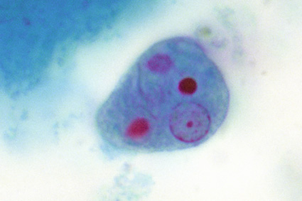
Amebiasis:
C/P:
Intestinal:
Acute onset of mild diarrhea. or
Amebic dysentry: perfuse diarrhea with blood, tenesmus, severe abd. pain
Extra intestinal:
- amebic liver abscess (fever, sweats, RUQ pain, high WBCs..)
-may invade lung or brain also..

Slide 17
Amebiasis:
Diagnosis:
Stool microscopy
Fecal antigen detection
Serology
US/CT .. Aspiration
Treatment:
metronidazole:
With diloxanide furoate (cyst)
Tinidazole ( severe )

Slide 18
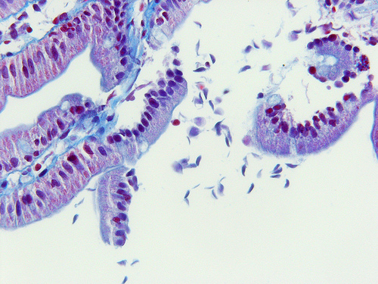
Giardia lamblia:
is transmitted through ingestion of cysts from contaminated food or drinks.
Adheres to microvilli of dudenal or jejunal epithelium.

Slide 19
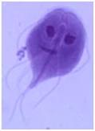
Giardia lamblia:
C/P :
diarrhea
Bloating , flatulence
Abdominal pain
Explosive diarrhea
Malapsorption
Weight loss

Slide 20
Diagnosis:
Direct fluorescent antibody (DFA) >> gold standard
Stool microscopy>> may be (--)
Treatment:
Tinidazole
paromomycin

Slide 21
Celiac Disease

Slide 22
Celiac Disease:
abnormal small intestine mucosa due to intestinal reaction to gliadin, a component of gluten.
Etiology
Only autoimmune disease in which androgen (alpha-gliadin) is recognized.
Associated with other autoimmune diseases, especially thyroid disease.
Gluten, a protein in cereal grains, is toxic factor.
Associated with HLA-DQ2 and with HLA-DQ8

Slide 23
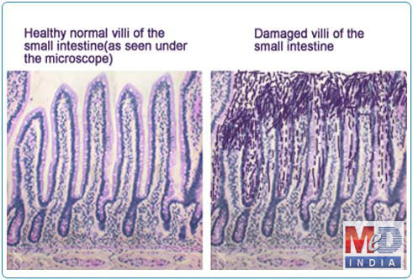

Slide 24
Celiac Disease:
Clinical Features
classically: diarrhea, weight loss, anemia, symptoms of vitamin/ mineral deficiency, failure to thrive; now more commonly bloating, gas, iron deficiency.
improves with gluten-free diet, deteriorates when gluten reintroduced.
disease is usually most severe in proximal bowel; therefore iron, calcium, and folic acid deficiency common

Slide 25
Celiac Disease:
Investigations:
small bowel mucosal biopsy (usually duodenum) :
villous atrophy and crypt hyperplasia
increased number of plasma cells and lymphocytes in lamina propria.

Slide 26
Celiac Disease:
Investigations:
Evidence of Malabsorption:
Steatorrhea
Low levels of ferritin/iron saturation, Ca, Fe, albumin, cholesterol, carotene, B12 absorption

Slide 27
Celiac Disease:
Investigations:
Serology:
anti-transglutaminase antibodies, TTG
Fecal fat >7% over 72 hrs

Slide 28
Celiac Disease:
Treatment:
Dietary counselling:
Gluten free diet: avoid barley, rye, wheat, maybe oats (if not contaminated by other grains).
Starchy foods e.g., rice are safe.
Iron, folate supplementation (with supplementation of other vitamins as needed)

Slide 29
Celiac Disease:
Prognosis:
associated with increased risk of lymphoma, carcinoma including small bowel and colon.
These can be avoided if adherent to diet.

Slide 30
Cystic Fibrosis

Slide 31
Cystic Fibrosis:
Autosomal Recessive.
Gene on long arm of chromosome 7 encoding for CFTR (Cystic Fibrosis Transmembrane Regulator).
CFTR is a Chloride channel regulating Chloride transport and possibly sodium.
This is responsible for elevated sweat chloride in 99% of patients.

Slide 32
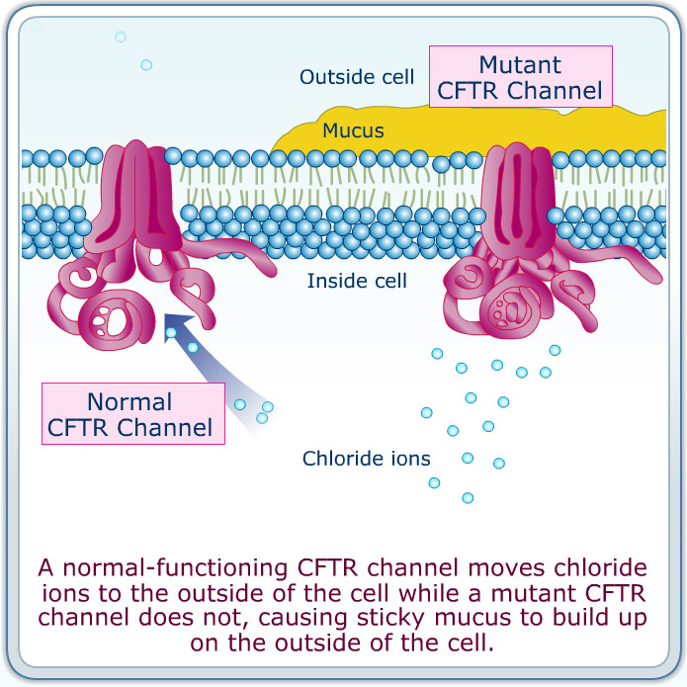

Slide 33
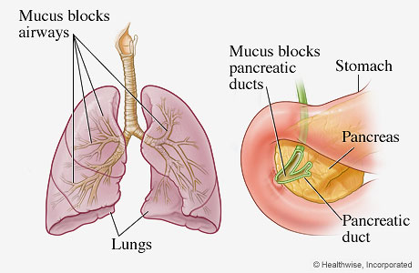
Cystic Fibrosis:
CF is characterized by widespread exocrine dysfunction.

Slide 34
Cystic Fibrosis:
GI Manifestation:
More prominent in infants.
Meconium ileus.
Greasy stools and fl atulence.
Pancreatitis.
Biliary cirrhosis.
Jaundice.

Slide 35
Cystic Fibrosis:
GI symptoms are more prominent in infancy, while pulmonary manifestations predominate thereafter.

Slide 36
Cystic Fibrosis:
Dx.:
Sweat chloride Test:
> 60 mEq/L.
Genetic analysis:
Are confirmatory.

Slide 37
Cystic Fibrosis:
Others:
DM.
Infertility.
Unexplained hyponatremia.
Fat soluble vitamins (A, D, E, K) deficiency.
..etc.

Slide 38
Cystic Fibrosis:
Management.:
Pulmonary manifestations :are managed with chest physical therapy, bronchodilators, corticosteroids, antibiotics, and DNase.
Administer pancreatic enzymes and fat-soluble vitamins A, D, E, and K for malabsorption.
Nutritional counseling and support with a high-calorie and high-protein diet are essential for health maintenance.

Slide 39
IBD
Crohn’s Disease
Ulcerative Colitis

Slide 40
Inflammatory Bowel Diseases IBDs:
Epidemiology:
More common Jewish.
The incidence of IBDs is increasing especially in industrialized countries.
Environmental factors are needed to drive the disease in genetically susceptible individuals.
30 folds increased risk in those with first degree relatives involved.

Slide 41
Crohn’s Disease:
May involve any part of GIT.
The commonest site is illeocecal junction.
Discontinuous pattern “ SKIP LESIONS ”.
Rectum is often spared.

Slide 42
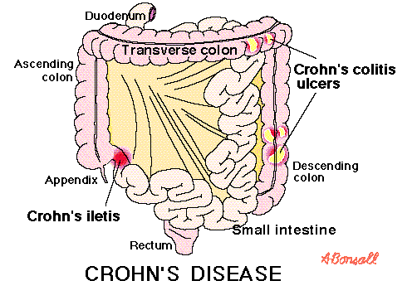

Slide 43
Crohn’s Disease:
C/P:
Abdominal pain.
Abdominal tenderness.
Abdominal mass.
Low grade fever.
Weight loss.
Watery diarrhea.
Perianal fissure/fistula.

Slide 44
Ulcerative Colitis:
Mainly affect the colon.
The rectum is always involved.
May extend proximally in a continuous fashion.

Slide 45
Ulcerative Colitis:
C/P:
Bloody diarrhea.
Lower abdominal cramps.
Tenesmus.
Urgency.
Abdominal pain/tenderness.
Blood on rectum.
Usually, no abdominal mass.

Slide 46
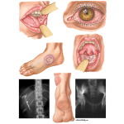
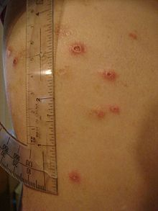
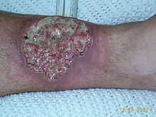
Extraintestinal Manifestations of IBDs:
Aphthous stomatitis,
Episcleritis/uveitis,
Arthritis,
Erythema nodosum,
Pyoderma gangrenosum.

Slide 47
Inflammatory Bowel Diseases IBDs:
Investigations:
Blood test.
Endoscopy.
Colonscopy.(biopsy)
Plane Abdominal XR.
US, CT.

Slide 48
Inflammatory Bowel Diseases IBDs:
Management:
5-ASA.
Steroids.
Azathioprine.
Infliximab
MTX.
-surgical

Slide 49
Glucose-galactose malabsorption

Slide 50
Glucose-Galacose Malabsorption:
a condition in which the cells lining the intestine cannot take in the sugars glucose and galactose.
Generally becomes apparent in the first few weeks of a baby's life.

Slide 51
Glucose-Galacose Malabsorption:
C/P:
Severe diarrhea.
Life-threatening dehydration,
Increased acidity of the blood and tissues (acidosis), and
weight loss
This occurs when fed breast milk or regular infant formulas.

Slide 52
Glucose-Galacose Malabsorption:
C/P:
However, they are able to digest fructose-based formulas that do not contain glucose or galactose.
Some affected children are better able to tolerate glucose and galactose as they get older.

Slide 53
Glucose-Galacose Malabsorption:
C/P:
Small amounts of glucose in the urine (mild glucosuria).
Affected individuals may also develop kidney stones or more widespread deposits of calcium within the kidneys.

Slide 54
Familial Chloride Losing Enteropathy

Slide 55
Familial Chloride Losing Enteropathy:
An inherited defect of chloride absorption in ileum and colon.
Defect in chloride-bicarbonate exchange protein.
Presents since birth with abdominal distension and watery diarrhea.

Slide 56
Approach

Slide 57
History:
Age:
Duration:
Consistency? Blood? Mucus? Pus?
Offensive?
Frequency?
Volume?
Associated symptoma:
Vomiting? Fever? Abdominal pain? Tenesmus? Convulsion? Cough? Appetite? Weight loss? Height intolerance? Tremorr?
Type and quantity of milk? Food?

Slide 58
History:
Allergy to food?
Past history of similar attack? How frequent?
Past Medical and Surgical Histoty?
Family hx of a similar condition?
Living conditions?
Drug history?
Travel history?

Slide 59
PHYSICAL EXAMINATION

Slide 60
GENERAL:
General appearance and mental status
Vital signs
Growth Parameters: FTT???
Hydration assessment.
Orthostasis- volume depletion,autonomic dysfunction

Slide 61
Pallor?
Exophthalmos (hyperthyroidism)
Aphthous ulcers (IBD and celiac disease)
Lymphadenopathy (malignancy, infection or Whipple's disease)
Thyroid Examinations:
Clubbing (liver disease, IBD, laxative abuse, celiac disease,)

Slide 62
SKIN LESIONS
Dermatitis herpetiformis (celiac disease)
Erythema nodosum and pyoderma gangrenosum (IBD)
Hyperpigmentation (Addison's disease)

Slide 63
ABDOMINAL EXAMINATION
Surgical scars
Abdominal tenderness
Masses
Hepatosplenomegaly
Auscultation:
Malabsorption
bacterial overgrowth
obstruction, or rapid intestinal transit.

Slide 64
PERINEAL AND RECTAL EXAMINATION
Ulcers
fissures
abscesses
Fistulas
stenoses.

Slide 65
SYSTEMIC EXAMINATION
Chest Examinations?
Joints: Arthritis (IBD, Whipple's disease)

Slide 66
INVESTIGATIONS

Slide 67
INVESTIGATIONS:
Investigations are directed by clinical findings:
CBC.
Stool culture.
Electrolytes.
RFTs.
endoscopy, clonoscopy,
TFTs,
Antibody test for celiac disease.
Sweat chloride test.
Trial of lactose restriction? Lactose breath hydrogen.

Slide 68
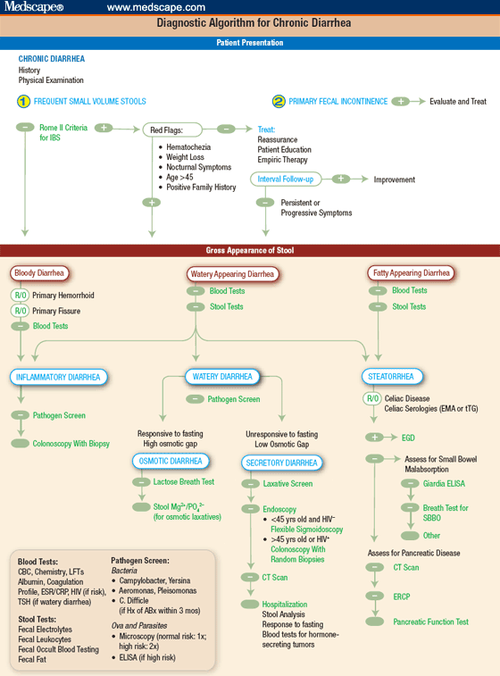

Slide 69
Conclusion:

Slide 70
Conclusion:
Chronic diarrhea lasts more than 2 weeks.
Has wide range of causes.
Causes can be infectious, familial , inherited, metabolic,…
May interfere with normal growth of child.
Careful assessment and detection of the underlying cause is needed to prevent serious sequele.

