Slide 1
ENCEPHALITIS
Presented by :
51: Abdulaziz Al-Qahtani
52: Abdulhai Al-Amri
53: Abdulelah Al-Qarni

Slide 2
CONTENTS
ENCEPHALITIS :
Definitions .
Etiology .
Clinical Manifestations .
Investigations .
Treatment .
Complications .
HERPES SIMPLEX ENCEPHALITIS :
Overview .
Pathophysiology .
Clinical Manifestations .
Investigations .
Treatment .

Slide 3
Definitions
Encephalitis
Inflammation of the brain parenchyma, present as diffuse and/or focal neuropsychological dysfunction .
Meningitis
Inflammation of the meninges ( membranes surrounding the brain and spinal cord ) .
Meningoencephalitis
Inflammation of the meninges and brain parenchyma .

Slide 4
Etiology
The cause of encephalitis is usually infectious.
Viral Causes:
Enteroviruses (it is the most common cause of the viral infection)
Herpesviruses (it is the most common cause of the complications)
Arboviruses.
Adenoviruses .
Rabies virus .
Rubella virus.
Measles virus .
Mumps virus .

Slide 5
Etiology
Bacterial and other causes :
Mycoplasma species and those causing rickettsial or cat-scratch disease, are rare and invariably involve inflammation of the meninges out of proportion to their encephalitic components .
Syphilis .
Toxoplasmosis , malaria , primary amoebic meningoencephalitis and Lyme disease .

Slide 6
Clinical Manifestations
The clinical presentation and course can be markedly variable .
The acuity and severity of the presentation correlate with the prognosis .

Slide 7
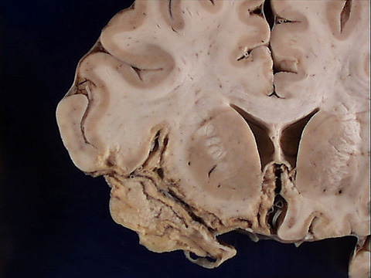
Clinical Manifestations
Acute infectious encephalitis usualy preceded by prodrome of several days of nonspecific symptoms such as cough, sore throat, fever, headache and abdominal complaints, followed by progressive lethargy, decreased level of consciousness, seizure, behavioral changes and neurologic deficits.

Slide 8
Clinical Manifestations
The specific prodrome in encephalitis caused by (herpesviruses ) such as varicella-zoster virus, Epstein-Barr virus or cytomegalovirus, and measles or mumps viruses includes srash, lymphadenopathy, hepatosplenomegaly, and parotid enlargement .
N.B: you have to look for vesicles in case of varicella zoster!!

Slide 9
Clinical Manifestations
Dysuria and pyuria are reported with St. Louis encephalitis (arbovirus) .
Extreme lethargy has been noted with West Nile encephalitis (arbovirus) .
Seizures are common at presentation.
Children with encephalitis also may have a maculopapular rash and sever complications ( coma, myelitis and peripheral neuropathy ) .

Slide 10
ADEM
Acute disseminated encephalomyelitis (ADEM) :
Is the abrupt development of multiple neurologic signs related to an inflammatory , demyelinating disorder of the brain and spinal cord .
ADEM follows childhood viral infections such as measles and chickenpox or vaccinations and resembles multiple sclerosis clinically .

Slide 11
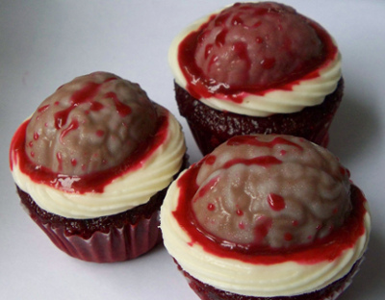

Slide 12
Investigations
lumbar puncture (L.P)
procedure usually reveals increased amounts of protein and white blood cells (mainly lymphocytes) with normal glucose levels (but it will decrease with Mumps and Herpes infection) , though in a significant percentage of patients , the cerebrospinal fluid may be normal.
EEG
Is the definitive test and shows diffuse slow wave activity, although focal changes may be present in one or both of the temporal lobes.

Slide 13
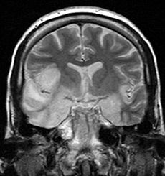
Investigations
Neuroimaging studies ( CT , MRI )
may be normal or may show diffuse cerebral swelling of the parenchyma or focal abnormalities (i.e. you will see (on MRI) lesion in the temporal lobe).
SEROLOGY
By detection of antibodies in the cerebrospinal fluid against a specific viral agent .
PCR (it is the best choice when you suspect herpes simplex infection)
BRAIN BIOBSY
Rare .

Slide 14
Treatment
No specific therapy for viral encephalitis (with exception of HSV , HIV , varicella zoster and cytomegalovirus) .

Slide 15
Treatment
The management is supportive and frequently requires ICU admission to facilitate aggressive therapy for seizures, timely detection of electrolyte abnormalities and, when necessary, air monitoring and protection or reduction of intracranial pressure and maintenance of adequate cerebral perfusion pressure .

Slide 16
Treatment
Corticosteroids are used to reduce brain swelling and inflammation.
Sedatives may be needed for irritability or restlessness.
When the diagnosis of HSE is suspected or has been established, Acyclovir is the treatment of choice (for 14 days).
(Also, you give the patient Abx along with the Acyclovir to treat meningitis when you suspect meningitis inf. )

Slide 17
Complications
Some people will make a good recovery after having encephalitis, particularly if they received a prompt diagnosis and treatment. However, in some cases, a person will develop one or more long-term complications due to the underlying injury to the brain.

Slide 18
Complications
Brain edema
Personality changes .
SIDAH (Syndrome of inappropriate ant diuretic hormone hyper secretion)
Memory problems .
Intellectual disabilities .
Lack of muscle coordination .
Paralysis .
Epilepsy .
Hearing or vision defects .
Speech impairments .

Slide 19
Complications
Complications of severe illness
Respiratory arrest .
Coma .
Death .

Slide 21
HERPES SIMPLEX ENCEPHALITIS -HSE-

Slide 22
Overview
Herpes simplex is a viral disease caused by both Herpes simplex virus type 1 and type 2, it is enveloped, double-stranded DNA virus .
It can be Oral, Genital, ocular ( keratitis ) or cerebral ( encephalitis ) .
HSV-1 is the more common cause of adult encephalitis, it is responsible for virtually all cases in persons older than 3 months.
HSV-2 is responsible for a small number of cases, particularly in immunocompromised or neonatal hosts .

Slide 23
Overview
It presents as blisters containing infectious virus particles that last 2–21 days, followed by a remission period . After initial infection, the viruses are transported along sensory nerves to the sensory nerve cell bodies, where they become latent and reside life-long .
In a remission period, the disease multiplies new virus particles in the nerve cell and these are transported along the axon of each neuron to the nerve terminals in the skin, where they are released .

Slide 24
Pathophysiology
Brain infection is thought to occur by means of direct neuronal transmission of the virus from a peripheral site to the brain via the trigeminal or olfactory nerve .
HSE represents a primary HSV infection in about one third of cases, the remaining cases occur in patients with serologic evidence of preexisting HSV infection and are due to reactivation of a latent peripheral infection in the olfactory bulb or trigeminal ganglion or to reactivation of a latent infection in the brain itself .

Slide 25
Clinical Manifestations
Fever .
Headache .
lethargy, poor feeding, irritability and confusion .
Seizures .
Vomiting .
Focal weakness .
Memory loss .

Slide 26
Clinical Manifestations
Signs and symptoms of neonatal HSE develop about 6-12 days after delivery, Those with disseminated disease also have abnormal liver function test results and thrombocytopenia .
Findings of HSV infection in neonates (aged 1-45 d) may include the following :
Herpetic skin .
Keratoconjunctivitis .
Oropharyngeal involvement, particularly buccal mucosa and tongue .
Encephalitis symptoms, such as seizures, irritability, change in level of attentiveness or bulging fontanelles .
Additional signs of disseminated HSV, such as shock, jaundice and hepatomegaly .

Slide 27
Investigations
CBC : High WBCs .
MRI : Abnormalities could be Temporal lobe involvement , sometimes hemorrhagic, and early involvement of white matter are typical.
PCR : detection of HSV DNA .
CT .
EEG : has 84% sensitivity to abnormal patterns in HSE . Focal abnormalities eg, ( spike and slow or periodic sharp wave patterns over the involved temporal lobes ) or diffuse slowing may be observed . Finding of Periodic complexes and periodic lateralizing epileptiform discharges (PLEDs) are strongly suggestive of HSE .
Analysis of Cerebrospinal Fluid .
Viral cultures of CSF .

Slide 28
Treatment
Antiviral therapy :
When the diagnosis of HSE is suspected or has been established, Acyclovir is the treatment of choice .
20 mg/kg IV every 8 hours ( 60 mg/kg/d ) is currently recommended for neonatal HSE, This dosage is higher than that used in older children and adults.
Treat Increased intracranial pressure .
Management of seizure .
Steroid Therapy .

Slide 29
THANKS

