Slide 1
Neural Tube defects
MOJAHED ALAMRI
NASER ALGAHTANI
OMAR ALRUFAIDI
GASSAN ALANAMER

Slide 2
What is Neural tube defect ?
Failure of normal fusion of the neural plate to form neural tube during the first 28 days following conception .
Neural tube defects (NTDs) are one of the most common birth defects, occurring in approximately one in 1000 live births in the United States.

Slide 3
Prevalence
Increased incidence in families of Celtic and Irish heritage .
Increased incidence in minorities (genetic or environmental?)
Increased incidence in families
Neural tube defects (NTDs) are among the most common birth defects that cause infant mortality (death) and serious disability .

Slide 4
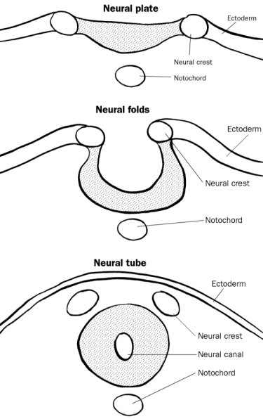
Neural Tube Development
Normal embryological development
Neural plate development -18th day
Cranial closure 24th day (upper spine)
Caudal closure 26th day (lower spine)

Slide 5
Etiology of NTDs
Combination of environmental and genetic causes .
Teratogens :
- Drugs
-Rdiation
Infection and maternal illnesses.
Nutritional deficiencies . - notably, folic acid deficiency

Slide 6
RISK FACTOR :
All pregnancies are at risk for an NTD. However, women with a history of a previous pregnancy with ( NTD).
women with first degree relative with(NTD)
women with type 1 diabetes mellitus
women with seizure disorders on Na valproic acid.
women or their partners who themselves have an NTD.

Slide 7
NTDs :
Two types of NTDs:
1- Open NTDs ( most common) :
- occur when the brain and/or spinal cord are exposed at birth through a defect in the skull or vertebrae.
Spina bifida
Anencephaly
Encephalocele

Slide 8
2- closed NTDs (Rarer type ):
- occur when the spinal defect is covered by skin.
lipomyelomeningocel
lipomeningocele
tethered spinal cord.

Slide 9
Neural Tube Defects
What are the common Neural Tube Defects (NTDs) ?
Spina Bifida - 60%
Anencephaly - 30%
Encephalocele - 10%

Slide 10
What is Spina Bifida?
- A midline defect of the :
bone,
skin,
spinal column, &/or
spinal cord.

Slide 11
Spina Bifida
Spina Bifida is divided into two subclasses :
1 - Spina Bifida Occulta(closed ) :
- mildest form ( meninges do not herniate through the opening in the spinal canal )
2 -Spina Bifida Cystic ( open) :
- meningocele and myelomeningocele .

Slide 12
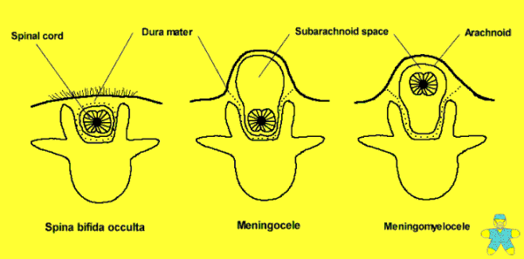
Spina Bifida

Slide 13
Spina bifida occulta
Failure of fusion of the vertebral arch .
The meninges do not herniate through the bony defect. This lesion is covered by skin.
Symbtoms :
Difficulties controlling bowel or bladder .
weakness and numbness in the feet
recurrent ulceration .
In Diastematomylia neurological deficits increase with growth.
Signs :
Overlying skin lesion :
tuft hair - lipoma - birth mark or small dermal sinus
Usually in the lumbar region .

Slide 14
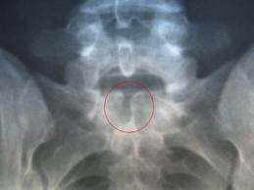
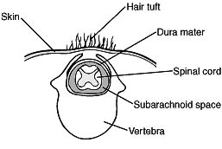
Spina bifida occulta
Diagnosis:
-indecently by X-ray.
- clinical.

Slide 15
Spina bifida manifesta
The 2 major types of defects seen here are myelomeningoceles and meningoceles.
lumobosacral regions are the most common sites for these lesions .
Cervical and thoracic regions are the least common sites.

Slide 16
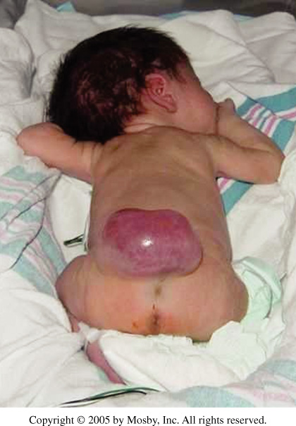
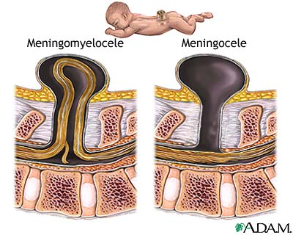
Myelomeningocele

Slide 17
Myelomeningocele
The spinal cord and nerve roots herniate into a sac comprising the meninges.
This sac protrudes through the bone and musculocutaneous defect.

Slide 18
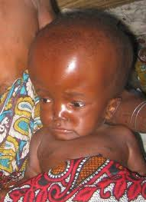
Myelomeningocele
Certain neurologic anomalies such as :
- hydrocephalus
- Chiari II malformation

Slide 19
Myelomeningocele
myelomeningoceles have a higher incidence of associated :
- orthopedic anomalies of their lower extremities ( why).
- Intestinal malformations.
- Cardiac malformations.
- esophageal malformations.
- renal and urogenital anomalies.

Slide 20
Symptoms & sings :
- Variable paralysis of the legs.
- muscle imbalance .
- Sensory loss .
- bladder denervation ( neuropathic )
- bowel denervation .
- scoliosis .
- Arnold chiari malformation .

Slide 21
Diagnosis :
-Antenatal :
- Elevated Alfa fetoprotein .
-US (Polyhydramonis ) .
At birth :
- Clinical finding .

Slide 22
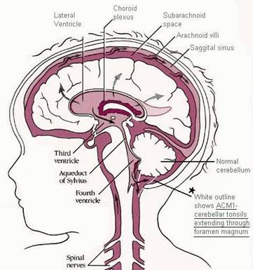
Arnold Chiari Malformation
Herniation of the cerebellar tonsils through the foramen magnum .
cerebellar hypoplasia .
caudal displacement
of the hindbrain through .
the foramen magnum .
usually associated with
Hydrocephalus .

Slide 23
Arnold Chiari Malformation
Hydrocephalus .
Cranial Nerve Palsies .
Visual Deficits .
Pressure from the enlarged ventricles affecting adjacent brain structures .
Cognitive and perceptual problems.
Motor dysfunction .

Slide 24
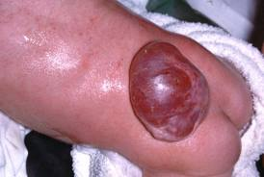
Meningocele
simply herniation of the meninges through the bony defect (spina bifida).

Slide 25
Meningocele
Fluid-filled sac with meninges involved but neural tissue unaffected .
The spinal cord and nerve roots do not herniate into this dorsal dural sac.
The primary problems with this deformity are cosmetic

Slide 26
Meningocele
Neonates with a meningocele usually have normal findings upon physical examination and a covered (closed) dural sac.
Neonates with meningocele do not have associated neurologic malformations such as hydrocephalus or Chiari II.
May complicted by CSF infection.

Slide 27
Lipomeningocele
Lipomeningocele
(lipo = fat)
lipoma or fatty tumor located over the lumbosacral spine.
Associated with bowel & bladder dysfunction
Lipomeningocele

Slide 28
Prognosis of Spina bifida
static
non-progressive defect
with worsening from secondary problems.
- The prognosis for a normal life span is generally good for a child with good health habits and a supportive family/caregiver.

Slide 29
Impairments associated with Spina Bifida
Abnormal eye movement
Pressure sore and skin irritations.
Latex allergy.
Bladder and bowel control problems
musculoskeletal deformities (scoliosis).
joint and extremity deformities (joint contractures, club foot, hip subluxations, diminished growth of non-weight bearing limbs)
Osteoporosis.
tethered spinal cord after surgery .

Slide 30
Treatment
surgical
Management
Prenatal screening
Triple Screen( alpha fetoprotein ,hcg ,esraiol )
Ultrasound
amniocentesis
complex and life long
Spine Xrays and/or spinal ultrasound

Slide 31
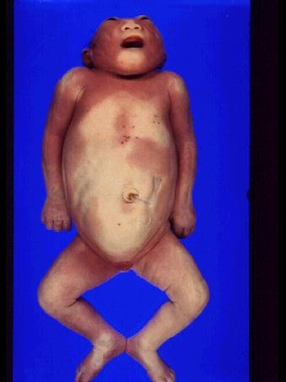
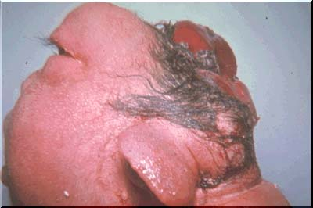
Anencephaly
Failure of development of most of the cranium and brain.
Infants are born without the main part of the forebrain-the largest part of the cerebrum.

Slide 32
The fetus usually blind, deaf and unconscious . partially destroyed brain, deformed forehead, and large ears and eyes with often relatively normal lower facial structures.
Both genetic and environmental insults appear to be responsible for this outcome.
The defect normally occurs after neural fold development at day 16 of gestation but before closure of the anterior neuropore at 24-26 days' gestation.

Slide 33
Anencephaly
Anencephaly is the most common major CNS malformation in the Western world,
no neonates survive. It is seen 37 times more in females than in males.
The recurrence rate in families can be as high as 35%.

Slide 34
Anencephaly
Symptoms
Mom- Polyhydramnios
Baby- absence of brain/skull
Diagnosis
Ultrasound
Treatment
None, incompatible with life
Management
Comfort Measures
Support Parents

Slide 35
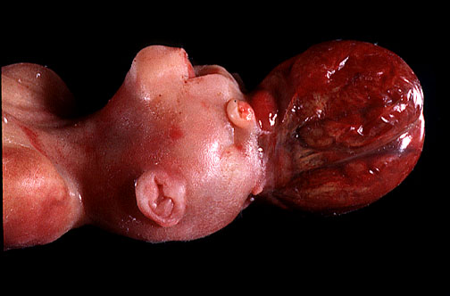
Encephalocele
Extrusion of brain and meninges through a midline
Skull defect .
- Often associated with cerebral malformation

Slide 36
Diagnosis and Detection
Amniocentesis
AFP - indication of abnormal leakage
Blood test
Maternal blood samples of AFP
Ultrasonography
For locating back lesion vs. cranial signs

Slide 37
How to Approach ?

Slide 38
History
C/C :
Bulging on the back or other deformity .
HPI :
Onset(at birth).
Size.
Course( progressive or constant)
Associated symptoms .
Past medical hx :
Previous medical problems .
Previous hospitalization.
Previous surgery or shunt .

Slide 39
Pregnancy & neonatal hx :
Follow up during pregnancy or no .
Mother’s illness during pregnancy .
Mother’s medication during pregnancy (anticonvlsion)
Exposure of the mother to radiation.
Exposure to high temperatures early in pregnancy
Taking Folic acid in 1st trimester.
Gestational age
Type of delivery
Birth weight
Other Congenital anomalies
Apgar scores
Admission to NICU
Developmental hx:
According to age .

Slide 40
Family & social hx :
Age of parents.
Consanguinity.
History of NTD in family .
History of diabetes of mother.
History of using anti-seizure for mother.
Obesity mother .
History of stillbirth or abortion
History of neonatal death in family.

Slide 41
Physical Examination
General examination:
Child appearance
Vital signs.
Growth parameter ( HC imp)
Examination of the head & neck :
Anterior Fontanel : wide bulging
Separated suture .
Dilated scalp vein .
Setting sun eye sign .
May be neck stiffness .

Slide 42
Examination of cranial nerve .
Examination of the back:
Inspection for deformity , scar, bulging( size, content)
pressure sores and skin irritations
sensation .
Examination of lower limps :
Inspection for deformity, muscle bulk .
Exam for tone and power (maybe paralysis)
Reflex and sensation ,
Gait .
Remember : urinary and bowel sphincters (maybe affected)

Slide 43
Management

Slide 44
Management varies according to the type and severity of neural tube defect

Slide 45
Treatment of mylomenigocele
- Genetic counseling may be recommended. In some cases where severe defect is detected early in the pregnancy, a therapeutic abortion may be considered
After birth - surgery to repair the defect is usually recommended at an early age. Before surgery, the infant must be handled carefully to reduce damage to the exposed spinal cord. This may include special care and positioning, protective devices, and changes in the methods of handling, feeding, and bathing.

Slide 46
Hydrocephalus:
- Children who also have hydrocephalus may need a ventricular peritoneal shunt
This will help drain the extra fluid
- Antibiotics may be used to treat or prevent infections such as meningitis or urinary tract infections

Slide 47
Most children will require lifelong treatment for problems that result from damage to the spinal cord and spinal nerves. This includes :
- Gentle downward pressure over the bladder may help drain the bladder. In severe cases, drainage tubes, called catheters, may be needed. Bowel training programs and a high fiber diet may improve bowel function
- Orthopedic or physical therapy may be needed to treat musculoskeletal symptoms. Braces may be needed for muscle and joint problems
- Neurological losses are treated according to the type and severity of function loss

Slide 48
- Follow-up examinations generally continue throughout the child's life. These are done to check the child's developmental level and to treat any intellectual, neurological, or physical problems

Slide 49
Treatment of menigocele
The key priorities in the treatment of meningocele are to prevent infection from developing through the tissue of the defect on the spine and to protect the exposed structures from additional trauma. Most children with meningocele are treated with surgery (within the first few days of life) to close the defect and to prevent infection or further trauma

Slide 50
Management of spina bifida occulta
- can remove fat or fibrous tissues which are affecting the functioning of the spinal cord
- can drain syrinxes or cysts in the spinal canal to reduce pressure on the spinal cord and
- can be performed on the legs or feet to improve their functioning

Slide 51
General management
- braces, supports and corrective casts
- physiotherapy to improve physical strength and coordination
- therapeutic strategies for improving mobility
- surgical care
- medical strategies for improving bladder and bowel functioning :
intermittent catheterization
voiding and cleansing routines
medications
diet with adequate fiber and fluids
possible surgical reconstruction (urinary)
- psychological strategies for personal and social adjustment
medications

Slide 52
SUMMERY :
Prevention
folic acid 0.4 mg daily pre, 1 mg daily preg
Identify
Prenatal
At birth
Protect pre-op and post-op
Skin integrity to prevent infection
Special handling to reduce nerve damage
Support
Parental coping
Pictures of similar defects corrected
Genetic Counseling
For future pregnancy
In early pregnancy, therapeutic abortion
Complications
Permanent disability
Education
Symptoms of hydrocephalus
Symptoms of meningitis
Follow up for monitoring to assess neurologic damage

Slide 53
How Can NTDs be Prevented?
All women of childbearing age should receive 0.4 mg (400 micrograms) of folic acid daily prior to conception of planned or unplanned pregnancies and continue thru 1st trimester
Women with a history of NTD and should receive daily supplementation of (4000 micrograms) of folic acid starting three months prior to conception and continuing thru the 1st trimester

Slide 54
THANK YOU

