Slide 1
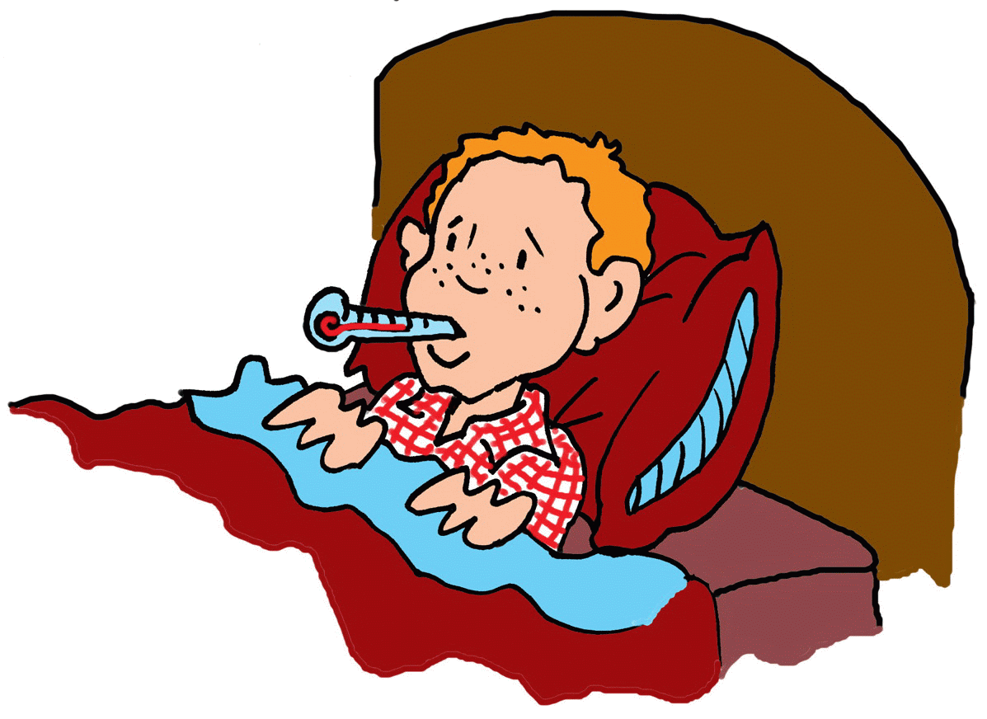
FEVER
Presented by:
ahmad j.albosaily

Slide 2
Definition:
Normal body temperature = 37 ° C ( 98.6 ° F).
Rectal temperature = Oral temp. + 0.6 ° C (1 ° F).
Rectal Temperature = Axillary temp. + 1.1 ° C (2 ° F).
Fever is:
A temperature ≥ 38 ° C ( 100.4 ° F ) using rectal temperature.

Slide 3
Definition:
Fever of Unknown Origin (FUO):
Fever ≥ 38 ° C lasting for more than 2 weeks for at least 4 occasions without any obvious cause.

Slide 4
PREVALENCE

Slide 5
Prevalence:
Fever is the 4th most common presenting symptom in family medicine clinics or phone calls.
The complaint crosses all age groups, both sexes.
It is less evident at extremes of ages.

Slide 6
HIGH RISK/ RED FLAGS

Slide 7
High Risk:
Any toxic appearance regardless of age.
Anyone with a temp. ≥ 40 °C regardless of age.
Neonates with a temp. ≥ 38 °C.
Infants (1-3 months) with a temp. ≥ 38 °C.
Children (3months – 6years) with a temp. ≥ 39 °C.

Slide 8
High Risk:
Children with a temp. ≥ 38 °C for ≥ 24 hours with no associated symptoms or no improvement with treatment.
Fever of unknown origin.
Confudsion.
Neck stiffiness.
Abdominal pain, chest pain,

Slide 9
High Risk:
Photosensitivity.
Dehydration.
Child with febrile convulsion.

Slide 10
RISK FACTORS

Slide 11
Risk Factors:
Chronic health problem e.g., DM.
Non-immunized child.
Malignancies.
Family hx. of CT diseases.
Contact with animals.
Recent travel.

Slide 12
Risk Factors:
Occupation.
Corticosteroids.
Indwelling catheter.
Homosexuality.

Slide 13
DIFFERENTIAL DIAGNOSIS

Slide 14
Differential Diagnosis:
Over clothing.
Infection.
Drugs (vaccination).
Soft tissue injury, inflammation.
Autoimmune diseases.
Malignancy.

Slide 15
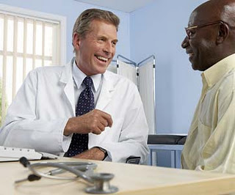
Diagnosis
Interviewing & History Taking

Slide 16
History Taking:
Biodata:
Name.
Age:
Birth – 3 months.
3 moths – 3years.
3 years and older.
Extremes of age (newborn & elder): the most serious.
Occupation:
Job related illnesses e.g., contact with animals.

Slide 17
History Taking:
Chief Complaints:
Fever.
Hx. of Presenting Complaints:
Onset.
Duration.
Grade.
Pattern.
Diurnal variation.

Slide 18
History Taking:
Associated Symptoms:
General: well? ill?
Children:
Pulling ear.
Decreased oral intake.
Diarrhea.
Dehydration.
Refuse to walk.
Level of activity.

Slide 19
History Taking:
Associated Symptoms:
Respiratory:
Rhinorrhea.
Sore throat.
Cough.
Otalgia.
GI:
Vomiting.
Diatthea.
Abdomial pain.
Jaundice.

Slide 20
History Taking:
Associated Symptoms:
GU:
Dysurea.
Frequency.
Urgency.
Hematurea.
Urin color.
Skin:
Rash.
Skin infection.
Skin wound.
Jaundice.

Slide 21
History Taking:
Associated Symptoms:
Head & Neck:
Redness of eyes.
Malar rash.
Headache.
Photosensitivity.
Neck rigidity.

Slide 22
History Taking:
Associated Symptoms:
Lethargy or irritibility. [ serious condition ]
Night sweating:
T.B.
Brucellosis.
Malignancy.
Weight loss:
T.B.
Malignancy.
Joint pain:
Rheumatologic diseases.
Brucellosis.
Rheumatic fever.

Slide 23
History Taking:
Impact (Effect):
Missing School or work.
Interference with daily activities.
Past Medical Hx.:
Chronic diseases e.g., DM.
Similar problem.
Infections: TB, or malaria.
Past Surgical Hx.:

Slide 24
History Taking:
Family History:
Similar problem.
Rheumatological diseases.
Infectious diseases.
Drug Hx.
Lifestyle:
Smoking.
Alcohol.
Hobbies: Animal contact; e.g., Brucellosis.

Slide 25
History Taking:
Psychosocial:
Idea: [caused by]
Concern. [worry]
Expectation.[investigation & ttt]
Psychological Hx.:
Depression.
Anxiety.
Stress.
Support system: Family, friends, transportation, telephone,…

Slide 26
Diagnosis
Physical Examination

Slide 27
Physical Examination:
General Appearance:
Pale,lethargic,dehydration,irritable or dull → serious bacterial infection
Vital signs:
Temperature:
Oral: for older children & adults.
Rectal: Infants & toddler.
Temp. chart
Pulse:
Respiratory Rate.
BP.
Wt. in children

Slide 28
Physical Examination:
Complete Systemic Examination:
Skin:
Rash.
Head & Neck:
Eyes:
Redness, jaundes, rhining,..
Bulging fontanells, nuchal rigidity (children).
Ears:
Redness or bulging tympanic membrane.
Nose: Rhinorrhea.
Mouth:
Hygiene.
Throat.
Tonsills.

Slide 29
Physical Examination:
Complete Systemic Examination:
Chest:
Breathing sound.
Crackles.
Wheezes, ronchi,.
Murmur.
Abdomen:
Tenderness,
Rigidity,
Organomegally,
Rectal exam.
Joints:
Swelling,
Erythema.
Limitation of movement.

Slide 30
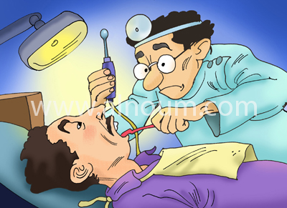
Management
CRAPRIOP:
Clarification.
Reassure.
Advice.
Prescription.
Referral.
Investigations.
Observation (follow up).
Prevention.

Slide 31
Management:
Clarification: “EXPLAINATION”
How to measure temperature.
Red flags.
Effect of fever on chronic conditions.
Appropriate use of treatment.
Reassure:
Depends on the underlying cause.
If self-limiting disease: explain that for him/her.
If serious: tell him/her that we have the best available care.

Slide 32
Management:
Advice:
Remove clothes.
Use sponge.
Come to professional care if there is a red fleg.
What should he/she do if having a chronic disease.
Seek care if no improvement.
Prescription:
Appropriate antipyratics.
Antibiotics, or antiviral depending on the underlying cause.
Appropriate treatment of the underlying cause.

Slide 33
Management:
Referral:
According to patient status and the underlying cause.
For hospitalization.
For further evaluation.
For further treatment.
Investigations:
Neonates & Infants (birth – 3 months):
Full septic work:
CBC, blood culture, UA, CXR, urine culture, CSF sample.

Slide 34
Management:
Investigations:
3months – 3 years:
Usually, they have identifiable cause & more reliable and investigations are directed according to appearance and temperature.
> 3years:
Usually, they have identifiable cause & more reliable and investigations are directed according to clinical findings.

Slide 35
Management:
Observation & Follow up:
Depends on:
Stability of the condition.
Presence of co-morbidity.
Underlying cause.
Prevention:
Vaccination.
Chemo-prophylaxis of contacts e.g., TB, malaria, meningitis, …
Teach about warning signs.
Teach about transmission of infections.
Teach about available treatment.

Slide 36
THANKS….
T
H
E
E
N
D
كن بسيطـًا تكن أجمــل ...

